Slide 1

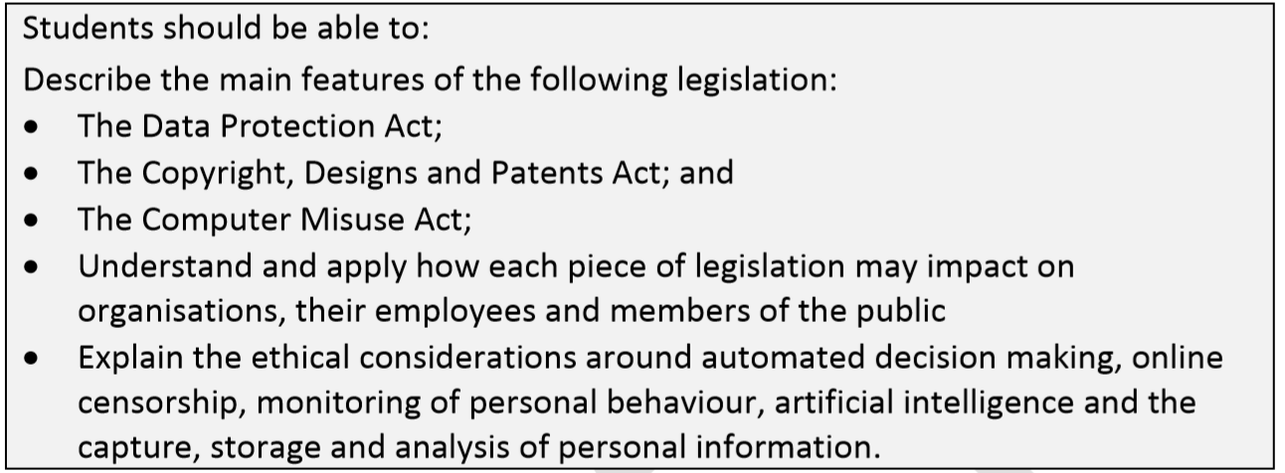
Individual, social and legal considerations

Slide 2
The 8 Principals of The Data Protection Act
1. Personal data should be processed fairly and lawfully with the consent of the data subject
2. Personal data should be used for the specified purpose only
3. Personal data should be adequate and relevant for its intended purpose
4. Personal data should be accurate and up to date
5. Personal data should not be kept for longer than necessary
6. Personal data should be processed in accordance with the rights of the data subject
7. Personal data should be held securely, with no unauthorised access
8. Personal data should not be transferred outside the EU
Notes:
5:44 min video linked
Updated for GDPR: https://www.youtube.com/watch?v=jwFoMe5vE-o&t=0s

Slide 3
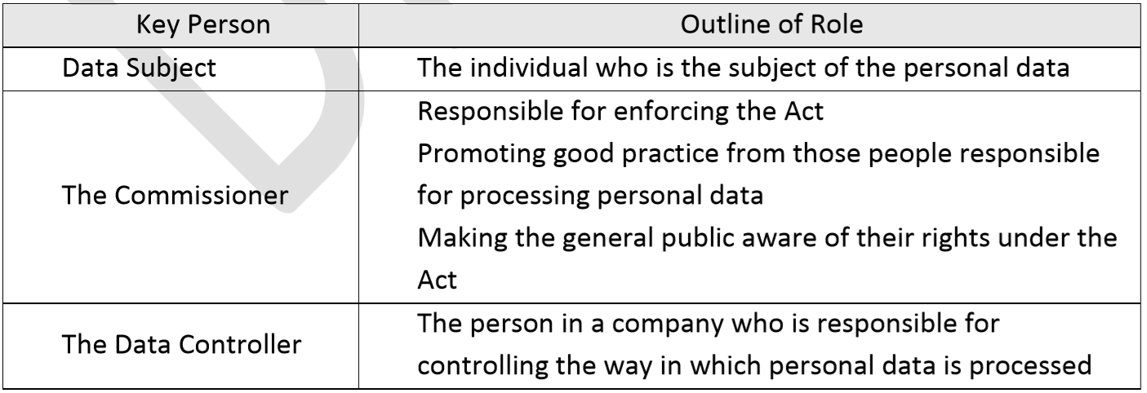
roles of key people
[These are Summary Descriptions – Please use BCS Glossary for full responses]

Slide 4
Data Protection Act 1998
Sets out requirements for the control of stored data about living individuals, both on computer systems and in other forms - covering many aspects of data privacy.
The Act also defines data controllers, the individuals who are respon­sible for the uses made of the computerised data.
Data controllers are required to notify the Information Commissioner, provid­ing details about the data they hold for the data protection register.
  This register enables any individual to find out if personal data relating to them is likely to be held and they have the right to ask for a copy of the data from the data controller.
  If the data is incorrect, the individual (as the data subject) is entitled to ask the data controller to have the data corrected.
  you have the right to find out what information is stored about you:
    how your data is being used
    object to how your data is processed in certain circumstances
Notes:
From BCS Glossary;

Slide 5
Understand and apply how the DPA may impact on organisations, their employees and members of the public
The main aim of this legislation is to protect the rights of individuals who have data held on them by organisations.
Under its terms the organisation is held responsible for the security, accuracy and conditions of use of the data it holds.
Organisations that do not comply with the terms of the DPA can be prosecuted.
It is therefore critical that all data-using organisations have procedures in place to ensure that data is held securely, that its accuracy is maintained and that it is used by the organisation correctly.
Organisations should ensure that procedures should be in place to ensure that data stored is accurate and up-to-date, for example through the use of validation and verification procedures. Ensuring that data is up-to-date may involve regular contact with data subjects, asking them to verify currently held details on a regular basis.

Slide 6
Understand and apply how the DPA may impact on organisations, their employees and members of the public cont.
Organisations also need to ensure that data stored is consistent with the requirement that data must only be used for the originally designated purpose.
They must also ensure that measures are in place to protect the integrity and physical security of the data held. This will involve implementing various security measures, including: physical access, system access, firewalls, back-ups, etc.
The organisation must also provide training to ensure that all staff is aware of data protection issues and of their personal responsibility for ensuring the terms of the act are complied with.

Slide 7
TASK
Research the rights the Data Protection Act Gives to the Data Subject.
Create a Mini fact file/poster in Microsoft Word outlining these rights to inform data subjects.
[7]

Slide 8
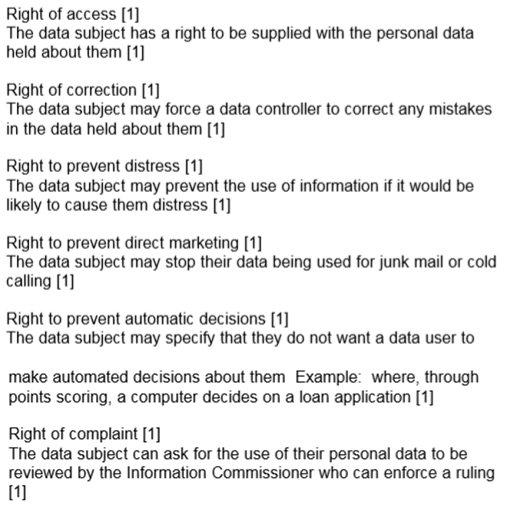
The Rights of the Data Subject

Slide 9


Slide 10
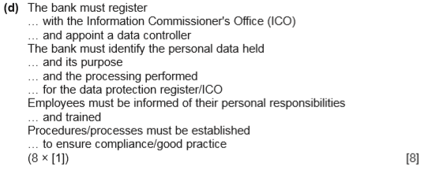

Slide 11
Main Features of The Copyright Designs and Patents Act
This law was designed to protect the “intellectual property” rights of those individuals and organisations that create and produce material based on original ideas. Material of this kind includes books, articles, music, films, software, etc.
Software piracy is a concern as this involves the illegal copying, modifying or downloading of software. By doing this they are avoiding the price of buying the software.
It can also be the ‘theft’ by one company of the ideas and methods of other ICT companies.

Slide 12
The impact of Copyright Designs and Patents legislation
Software piracy can take many forms such as individual users using the Internet to copy a piece of software to their own computers without permission to professional criminals making copies in bulk and selling them through illegal outlets.
The software industry believes that there are two negative effects of piracy.
  It results in higher prices for those customers who are buying software legally.
  It discourages software houses from being innovative in creating new software.
When organisations who use computer networks to purchase a piece of software, they also purchase a software licence for one or more users.
  They are then legally permitted to distribute the software to that number of users.
  If the organisation wants more users to access the software, then they have to pay for more licences.
  Licences have different categories, including Single, Multi-User and Site

Slide 13
The impact of Copyright Designs and Patents legislation cont.
For an organisation to enforce this law they have a responsibility to ensure that all employees are aware of the terms of the Act and the consequences of being in breach of it.
The organisation must also carry out audits on the software that it uses and monitors who has access to that software.
Organisations must fully comply with Licensing agreements and must control access to the software.
Employees should only be allowed to have authorised software on their PCs.
Organisations should also ensure that unauthorised software, perhaps brought from home or downloaded from the Internet, is not permitted in the workplace.

Slide 14
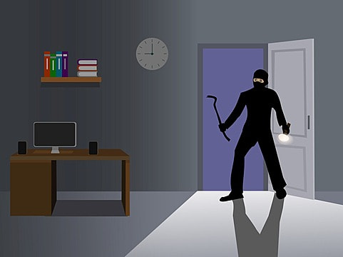
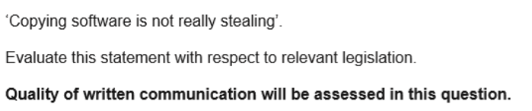
[6]

Slide 15
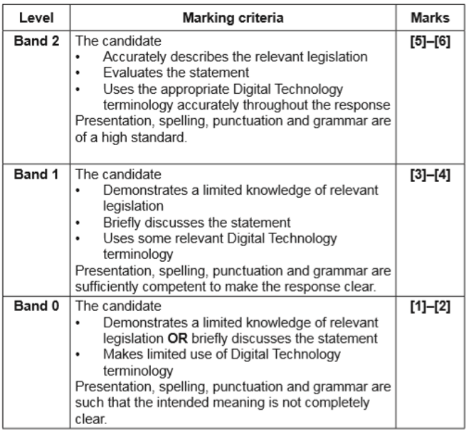
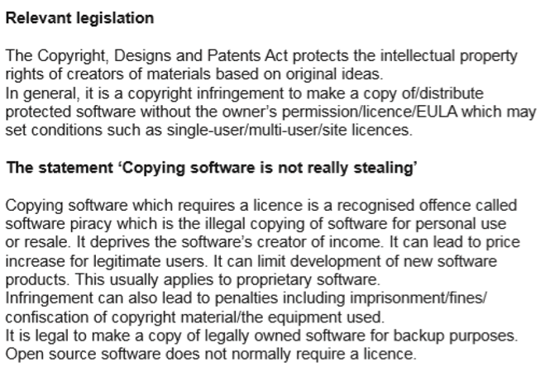

Slide 16
Main Features of The Computer Misuse Act
This act was designed to prevent computer crimes involving unlawful access to information systems or data files.
The act states that unauthorised access to computer material is an offence, unauthorised access with intent to commit or facilitate commission of further offences is also offence and unauthorised modification of computer material is a further offence.
It identifies specific crimes such as deliberately planting viruses in a computer system Hacking into someone’s computer system.

Slide 17
The impact of The Computer Misuse Act
Individual employees may use company resources to hack into other systems. If it were shown that the organisation was negligent in taking steps to prevent this, it could be held partly liable for the actions of its employees.
The organisation should put policies should be in place to ensure that employees are aware of the terms of the Act and the consequence of being in breach of it This would include an “Acceptable Use” policy including organisational disciplinary procedures.
Computer use by employees should be audited regularly and suspect access activity be fully investigated, through examining parts of the system that have been accessed by different employees at specified times.
By implementing a username and password system will mean access to different areas of the system is tightly controlled meaning employees should have only access rights that are necessary for the completion of their work.

Slide 18
Crimes Identified in the Computer Misuse Act
The three main offences highlighted in the act are:
Unauthorised access to computer material
Unauthorised access with intent to commit or facilitate commission of further offences
Unauthorised modification of computer material
It identifies specific crimes such as:
deliberately planting viruses in a computer system
hacking into someone’s computer system
data theft/fraud

Slide 19
Complying with the Computer Misuse Act
The organisation Acceptable usage policy should ensure that employees are aware of their obligations under the Act
IT use by employees should be audited regularly and suspect access activity be investigated
Implementing a username and password system to control/restrict employee access to computer systems
Individual employees may use company resources to hack into other systems. If it were shown that the organisation was negligent in taking steps to prevent this, it could be held partly liable for the actions of its employees.

Slide 20
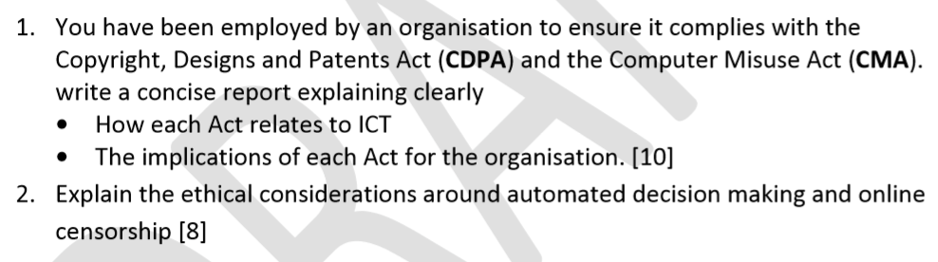
FACT FILE TASKS

Slide 21
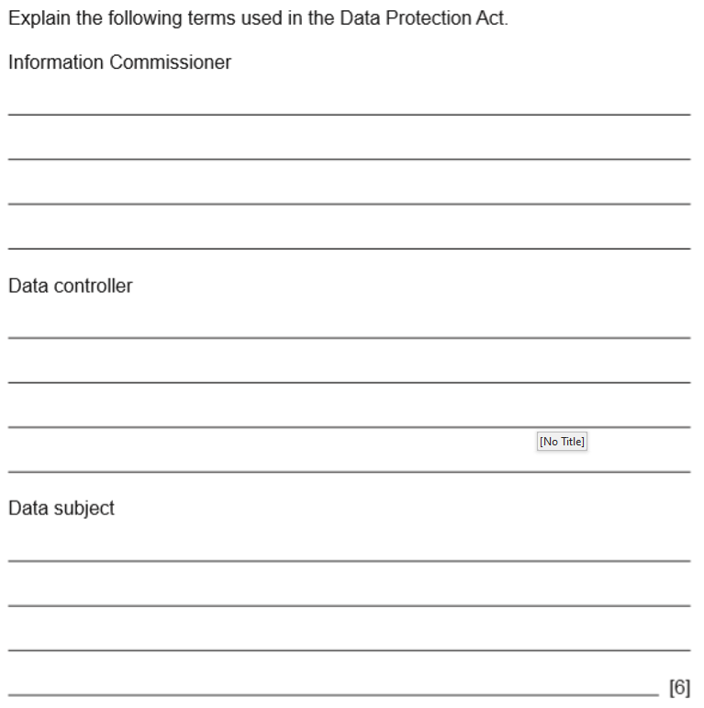

Slide 22
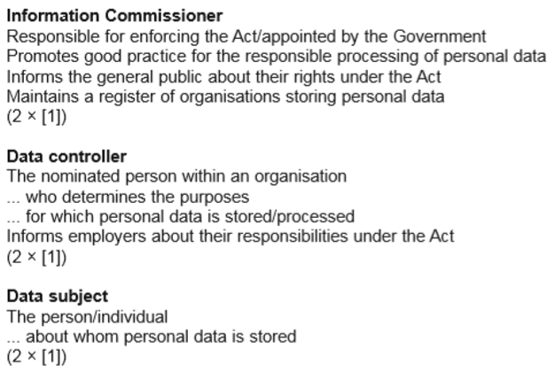

Slide 23
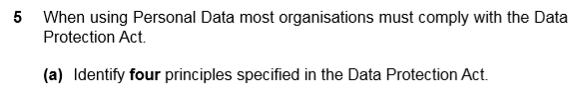
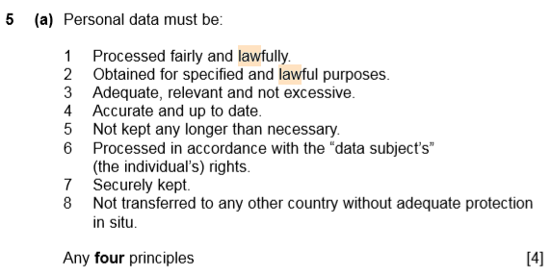
Specimen Paper Questions

Slide 24
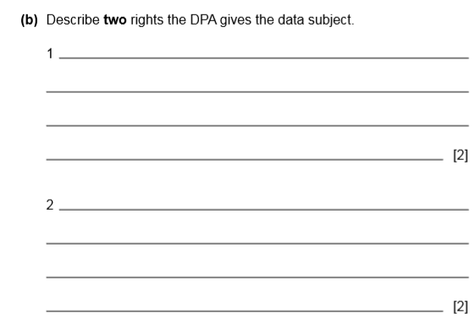
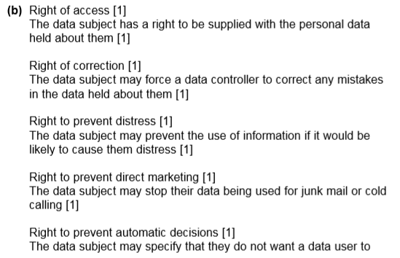
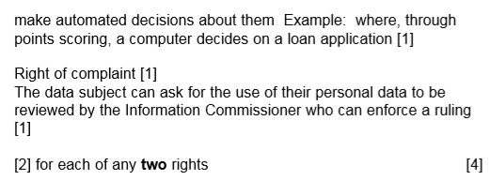

Slide 25

ETHICS
explain the ethical considerations around: − automated decision making; − online censorship; − monitoring of personal behaviour; − artificial intelligence; and − the capture, storage and analysis of personal information.

Slide 26
What are ethics?
Ethics are an accumulation of values and principles that address questions of what is good or bad in human affairs.
Ethics searches for reasons for acting or refraining from acting;
for approving or not approving conduct;
for believing or denying something about virtuous or vicious conduct or good or evil rules.

Slide 27
Many ethical issues revolve around privacy when using IT.
Should you read the private e-mail of your network users just because you can?
Is it OK to read employees’ e-mail as a security measure to ensure that sensitive company information isn’t being disclosed?
Is it OK to read employees’ e-mail to ensure that company rules (for instance, against personal use of the e-mail system) aren’t being violated?
Is it OK to monitor the Web sites visited by your network users? Should you routinely keep logs of visited sites? Is it negligent to not monitor such Internet usage, to prevent the possibility of pornography in the workplace that could create a hostile work environment?
Is it OK to place key loggers on machines on the network to capture everything the user types?
What about screen capture programs so you can see everything that’s displayed?
Should users be informed that they’re being watched in this way?
Is it OK to read the documents and look at the graphics files that are stored on users’ computers or in their directories on the file server?

Slide 28

The key point is that this is not about legislation. A company may very well have the legal right to monitor everything an employee does with its computer equipment.
  But what about the ethical aspects of having the ability to do so?
  For example, as a network administrator you have rights and privileges that allow you to access most of the data on the systems on your network.
You may even be able to access encrypted data if you have access to the recovery agent account.
  What you do with those abilities depends in part on your job duties
  for example, if monitoring employee mail is a part of your official job description and in part on your personal ethical beliefs about these issues.

Slide 29
Ethical Dilemmas
Then there are money issues. The proliferation of network attacks, hacks, viruses and other threats to their IT infrastructures have caused many companies to “be afraid, be very afraid.” As a security consultant, it may be very easy to play on that fear to convince companies to spend far more money than they really need to. Is it wrong for you to charge hundreds or even thousands of dollars per hour for your services, or is it a case of “whatever the market will bear?”
Another ethical issue involves promising more than you can deliver or manipulating data to obtain higher fees. You can install technologies and configure settings to make a client’s network more secure, but you can never make it completely secure. Is it wrong to talk a client into replacing their current firewalls with those of a different manufacturer, or switching to an open-source operating system – which changes, coincidentally, will result in many more billable hours for you – on the premise that this is the answer to their security problems?

Slide 30

Digital Theft and Copyright Violation
One of the biggest challenges that digitizing everything from music to movies has created has been the ease with which these assets can be stolen and shared at little or no cost and with no apparent penalties.
For example, is it okay for a friend to give you a digital copy of a song they purchased?
  Most people would say Yes.
  However, if you had spent time and money and had used your talent to record an album and discovered that it was shared without you being paid anything, would that be okay?

Slide 31

Privacy
What about the impact of the explosive growth of connected devices and what it means for our privacy?
We expose a significant amount of data online through searches and social media posts.
Many of our clicks generates to data that is sold to marketers and other third parties.

Slide 32
Online Censorship
IP addresses
A person's online activity can be tracked through their IP address. Like a postal address, an IP address identifies a computer and its physical location on the network.
The IP address is allocated to the network card of a machine by an internet service provider (ISP).
  An IP address does not always give a geographic location.
  A mobile phone might be anywhere in the world, but its IP address on a 3G or 4G network will still be traceable.
Computers are assigned an IP address, which can be used by ISPs to track internet activity
All online activity can be tracked using an IP address. This is a method used to detect criminals on the internet and can be used to trace malicious comments made online.
Proxy servers
IP addresses can be masked by using a proxy server. Anyone can use a proxy server. Many are set up by criminal gangs to entice people to download software with viruses, or to enter personal details about themselves.
They can also be used legitimately, eg by businesses to mask their internal company network.

Slide 33
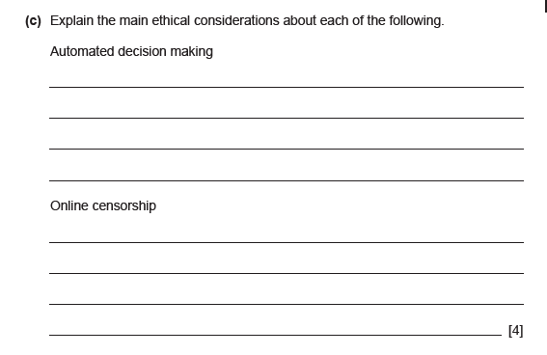

Slide 34
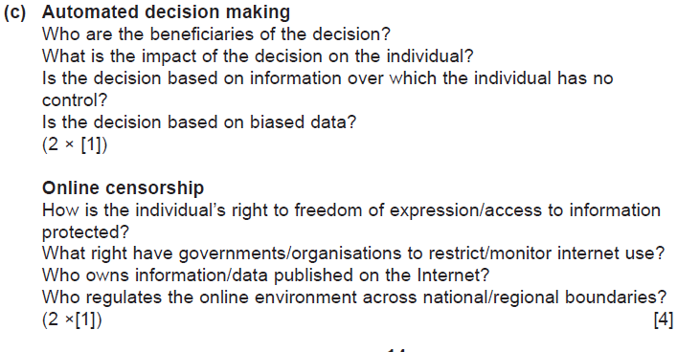

Slide 35
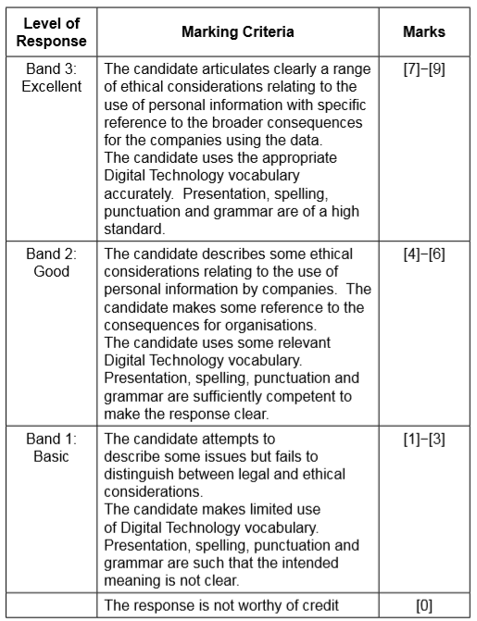
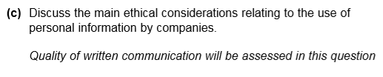
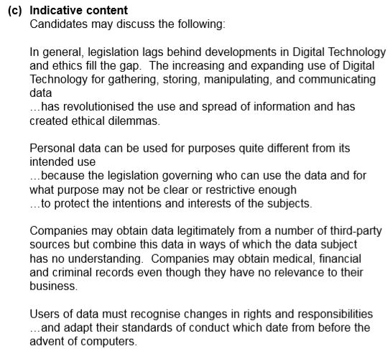

Slide 36
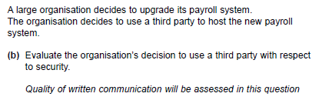
[9]

Slide 37


